Slide 1
Analysis Concepts Initial Perspectives from the CDISC Working Group
Karl Wallendszus, University of Oxford & Edwin van Stein, CDISC
PHUSE EU Connect – 18 November 2025
Paper DS05c

Slide 2



Meet the Speakers
Karl Wallendszus
Title: Analysis Programming Team Lead
Organization: Oxford Population Heath, University of Oxford
Karl Wallendszus is a statistical programmer in Oxford Population Health, a department of the University of Oxford, with over 30 years experience in large clinical trials. Karl was a volunteer in the CDISC team which developed the Analysis Results Standard (ARS), and is now in the Analysis Concepts team.
Edwin van Stein
Title: Consultant
Organization: CDISC
Edwin has over 20 years experience in programming and standards in pharma, biotech, CRO and academia. He is an active PHUSE member, contributing as presenter, stream chair, conference chair, working group lead and planning committee member. He is currently self-employed (Raccoon Consulting), working mostly for CDISC.
2
Notes:
The Session Chair will introduce you based on the information you provide on this slide.
Instructions:
1. Select one of the two ‘Meet the Speaker’ templates based upon how many presenters you have.
2. Insert a medium or high resolution professional bio photo of yourself and format it to the dimensions of the placeholder image(s).
3. Place bio photo(s) over the placeholder(s) and delete the placeholder image(s).
4. Fill in your name, title and organization in the text boxes provided.
5. Insert short bio’s in the text box provided. If the quantity of presenters does not allow adequate space for bios on the slide, delete this text and replace it with short bios of all presenters.

Slide 3
Disclaimer and Disclosures
The views and opinions expressed in this presentation are those of the authors and do not necessarily reflect the official policy or position of CDISC or Oxford University.
The authors have no real or apparent conflicts of interest to report.

Slide 4
Agenda
Introduction: goals, the bigger picture and plan - Karl
Details: purpose, AC/DC and model development - Edwin
4

Slide 5
Introduction
Goals, the bigger picture and plan
5

Slide 6
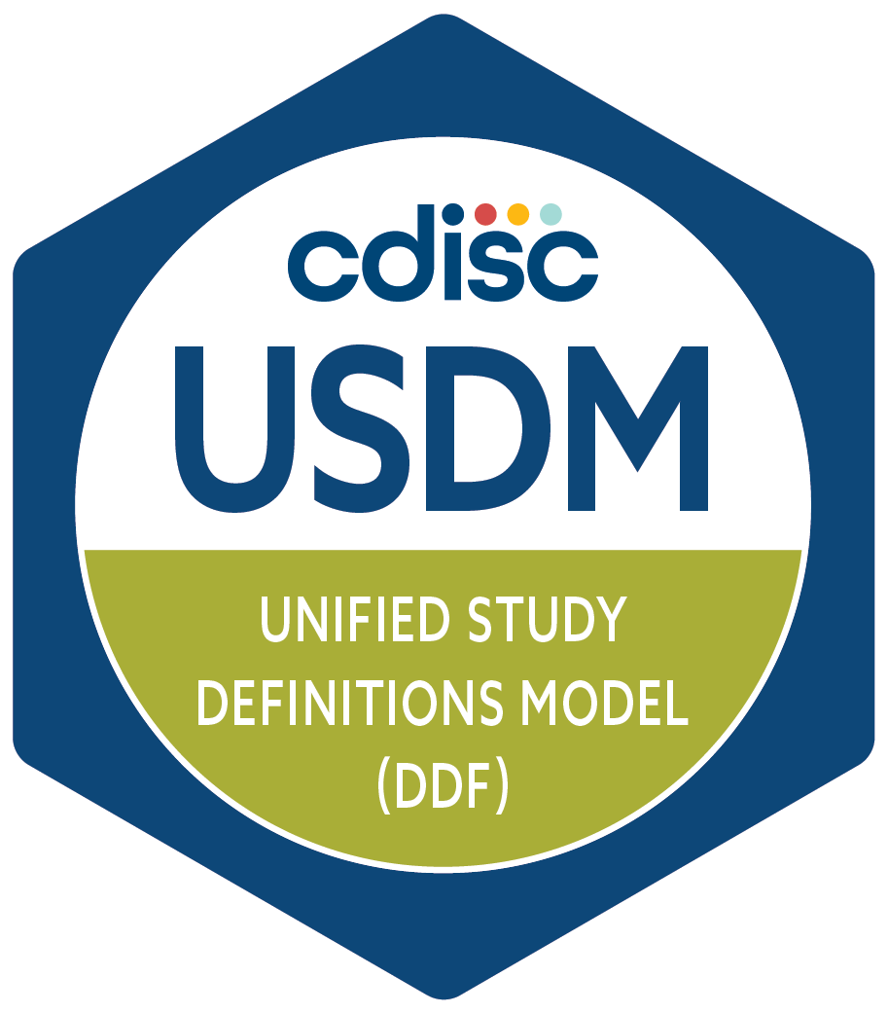
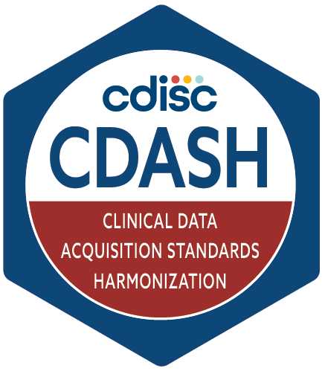
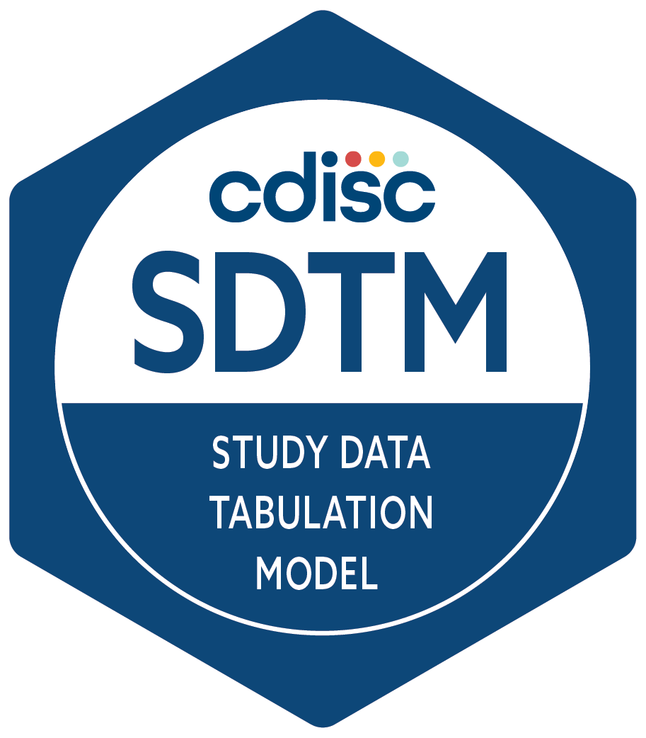
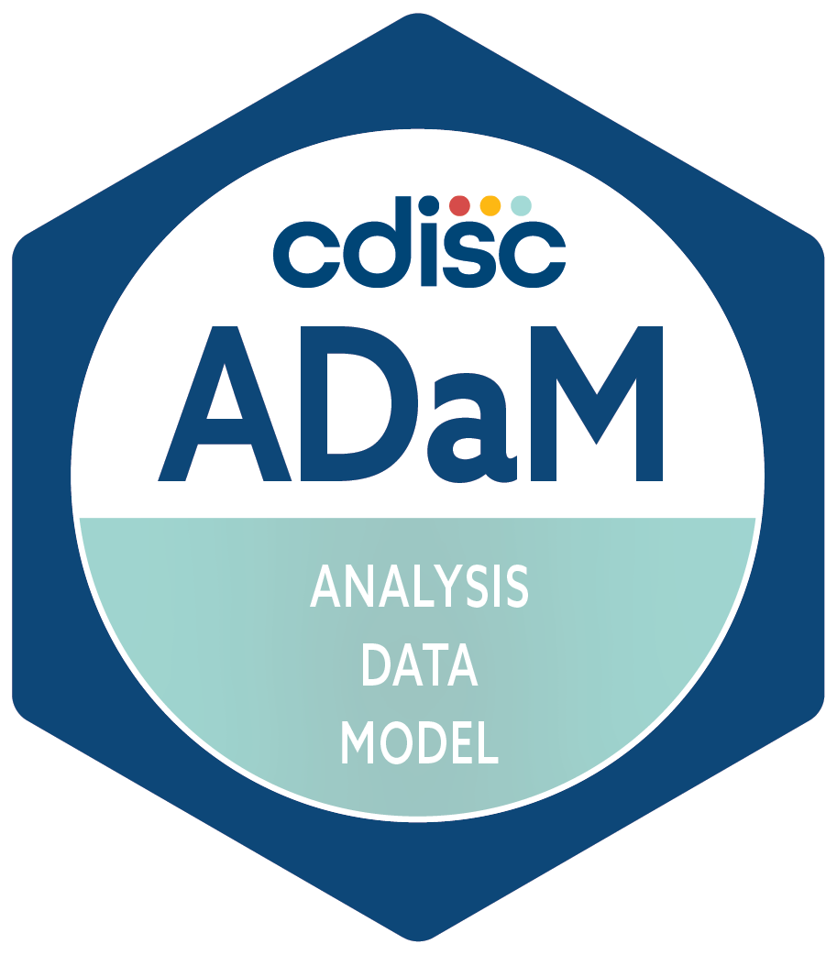
CDISC Standards – November 2025
Protocol
Data collection
Data
tabulation
Analysis data
Analysis results
Analysis outputs
CSR
Notes:
Looking at the trial life cycle, what CDISC standards do we currently have to facilitate automation?
First, the long-established familiar standards:
CDASH for data collection via eCRFs
SDTM provides a framework for representing clinical data once it has been collected. It’s about the presentation of data — not the intent or context behind it.
ADaM – Defines datasets designed to support statistical analyses and traceability back to SDTM.
To this we can add:
USDM to define the study structure

Slide 7
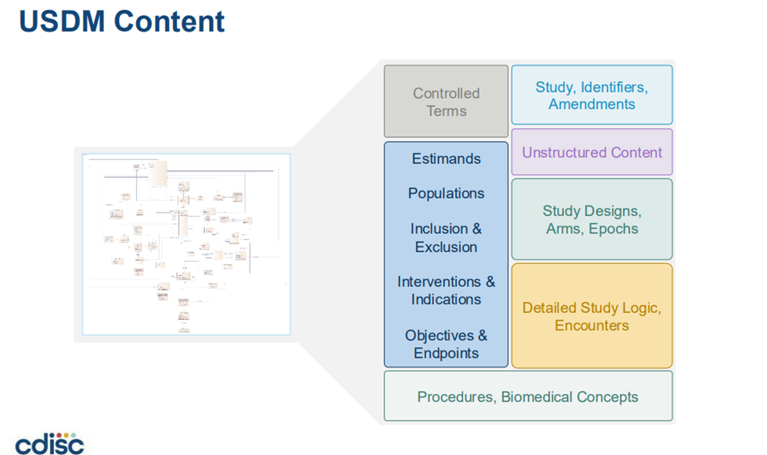
7
Notes:
USDM models lots of metadata defining the study structure, including the Schedule of Activities (SoA) – defines what data is collected when.
Includes elements relevant to the analysis, e.g. estimands, objectives, endpoints.
But when we drill down, some of this is in the form of text.
That is good for compiling a protocol, informing CRF design and many other aspects, but not detailed enough to completely define the analyses.

Slide 8
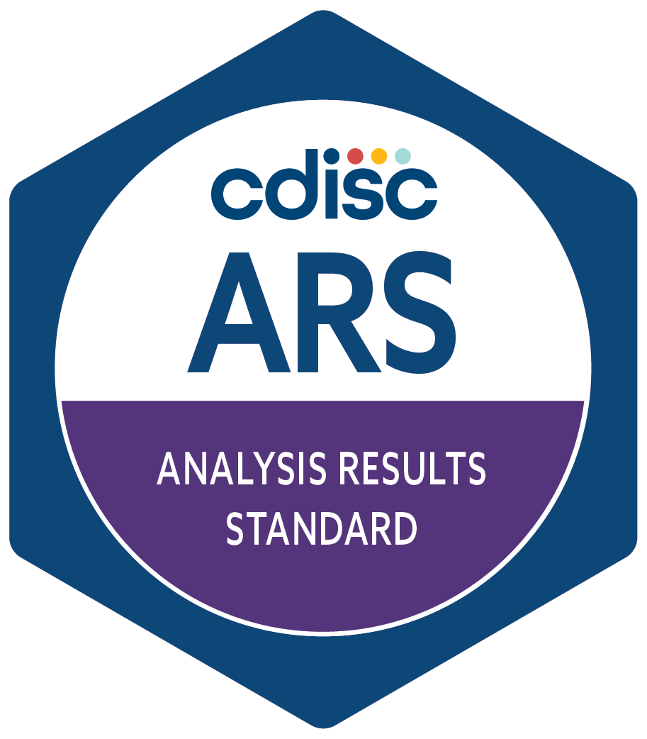
CDISC Standards – November 2025
Protocol
Data collection
Data
tabulation
Analysis data
Analysis results
Analysis outputs
CSR
Notes:
As of April 2024, we can now add the Analysis Results Standard.

Slide 9
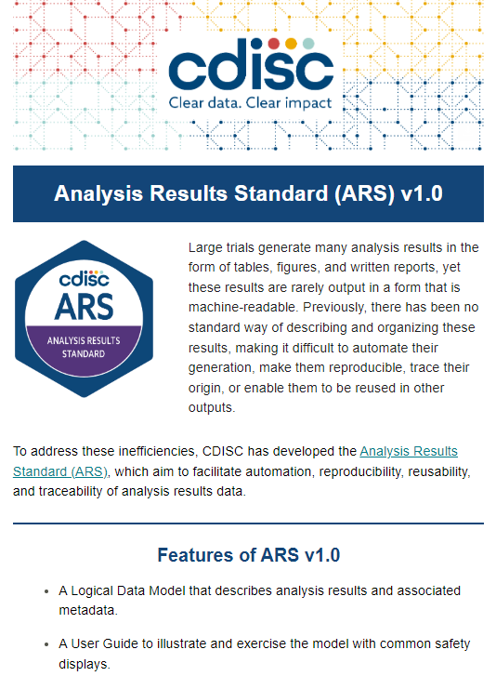
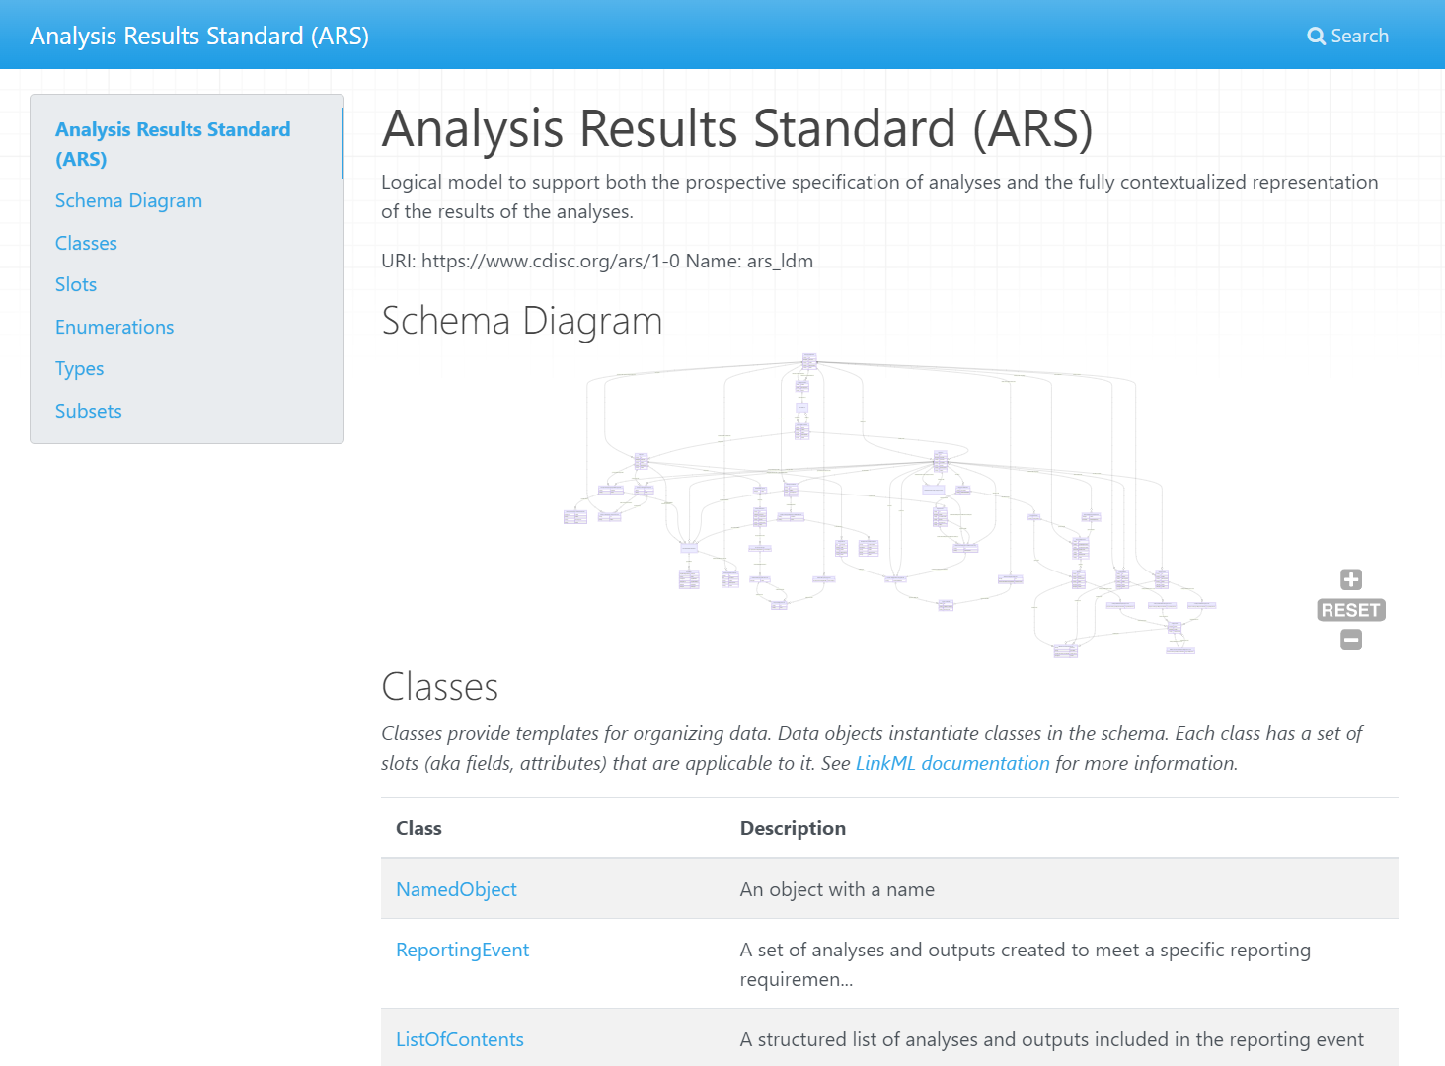
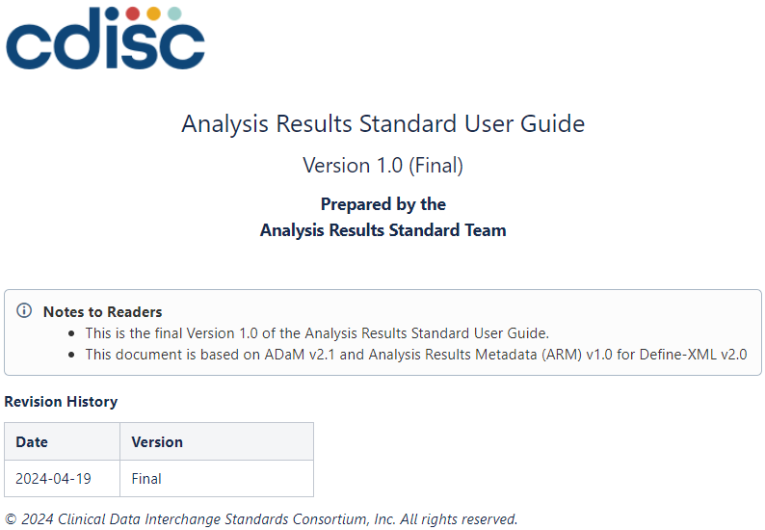
CDISC Analysis Result Standards – Released 2024
https://cdisc-org.github.io/analysis-results-standard/
https://wiki.cdisc.org/display/ARSP/Analysis+Results+Standard+User+Guide+v1.0
Notes:
ARS is a data model for the structure of analyses.
Can be used to specify analyses, facilitating automation.
Provides a structure for analysis results, separate from displays, facilitating validation, re-use and sharing.

Slide 10

CDISC Standards – November 2025
Protocol
Data collection
Data
tabulation
Analysis data
Analysis results
Analysis outputs
CSR
Notes:
Informing the design and collection steps, we also have Biomedical Concepts.

Slide 11
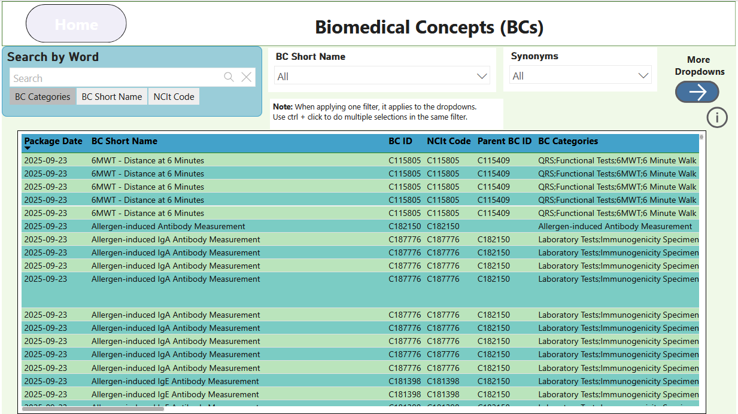
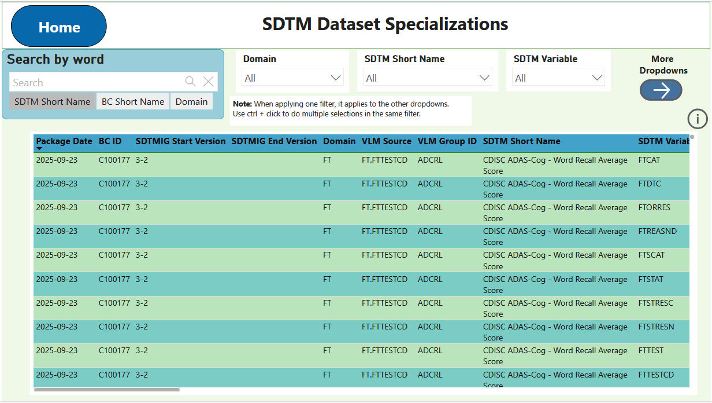
CDISC Biomedical Concepts
Notes:
Biomedical Concepts fill gaps in the current standards by adding semantics, variable relationships, and the detailed metadata.
Two-layered approach:
Conceptual/abstract layer that provides standards-agnostic, unambiguous semantic definition largely based on NCIt concepts.
An implementation layer consisting of SDTM Dataset Specializations provides value level definition that facilitates metadata-driven automation.
This was important for the AC team as we considered how Analysis Concepts might fit into the picture.

Slide 12
Where Analysis Concepts fit
Derivation Concepts
What needs to be derived to support the analysis?
Analysis Concepts
What analysis is needed to answer the question?
Protocol
Data collection
Data
tabulation
Analysis data
Analysis results
Analysis outputs
CSR
Notes:
We still thought there are gaps that prevent full language-agnostic definition of analyses and therefore block full automation.
E.g. How do we model the precise definition of an analysis to answer a particular question?
That is the sort of entity we can call an Analysis Concept.
As we started thinking about how to do this, we soon realized we also need a slightly different kind of concept.
The inputs to an analysis are often derived from the collected data in some way.
To completely understand an analysis we also need to understand those derivations, so those also need be modelled.
Hence the Derivation Concept.

Slide 13
User Stories
Use Case 1: Accelerating Study Start-Up
As a study statistician, I want to select from a library of Analysis Concepts so that I can quickly draft the digital Statistical Analysis Plan (SAP) and identify needed datasets and variables.
Use Case 2: Enabling Metadata-Driven Automation
As a clinical data standards expert, I want to build a structured repository of Analysis Concepts so that downstream automation tools (e.g., TFL code generators, validation scripts) can use them as inputs.
Use Case 3: Automating Standard Analyses Across Studies
As a statistical programmer, I want to use pre-defined Analysis Concepts so that I can automate the generation of standard TFLs across studies without recreating logic each time.
Notes:
We used user stories to scope what Analysis Concepts should be able to do. Example use cases:
Build a digital SAP.
Build a repository of reuseable ACs.
Automate analysis programming.

Slide 14
Analysis Concepts: Building Blocks for the Digital SAP
What AC Brings
Standardized, configurable elements & methods
Encodes clinical questions and expected outputs
Enables automation and consistency across studies
Why This Matters for SAP
SAPs today are static documents (Word/PDF) → hard to reuse or automate
AC provides a digital representation of analysis intent
Bridges the gap between what is collected and what is analyzed
Towards an eSAP Model
AC definitions serve as the foundation for a Digital SAP
Digital SAP → machine-readable, executable, and version-controlled
Drives automation of analyses, traceability, and regulatory alignment

Slide 15
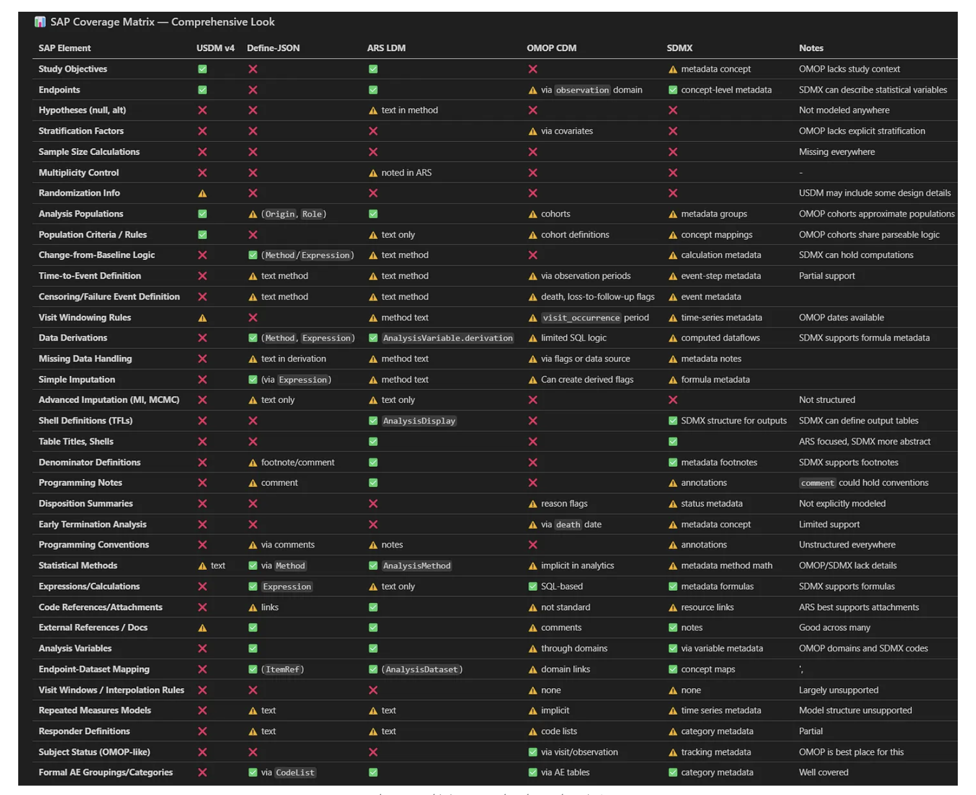
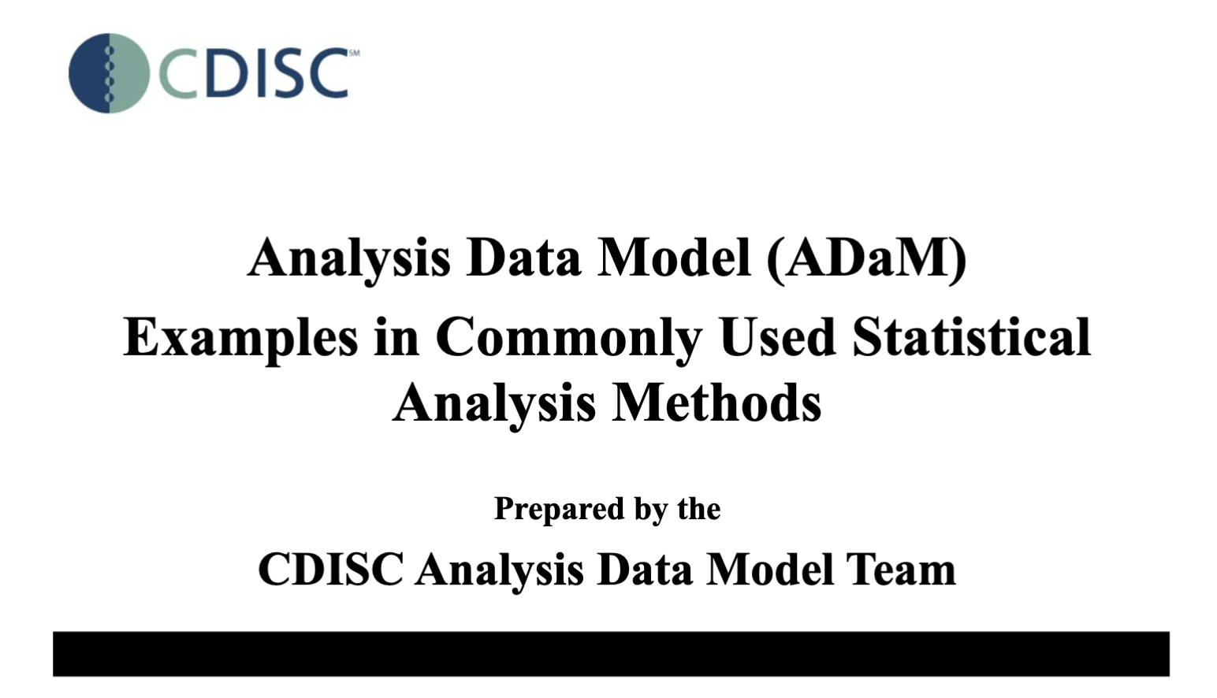
Approaches Considered
Top-Down
What elements are covered across sample SAPs?
What elements are covered across standards?
Bottom-up
What Analysis Concepts are needed for the most common statistical analyses?
Notes:
https://www.cdisc.org/standards/foundational/adam/adam-examples-commonly-used-statistical-analysis-methods - published 2011!

Slide 16
Details
Purpose, AC/DC and model development
16

Slide 17
Why Develop Analysis Concepts?
Interchange
Standardized structure allows interchange of analysis specifications between systems and organizations
Analysis automation and reuse
Machine-readable analysis specifications can directly link to statistical programming code reducing transcription errors, allowing automated validation and reuse
Reduced ambiguity
Standardized structure enforces precision in specifying analysis setting and assumptions
Increased traceability
Provides clear linkage from results all the way back to objectives and endpoints in USDM and vice versa
Streamlined collaboration
Provides common language between statisticians, clinicians, data managers, programmers and other stakeholders
#ClearDataClearImpact

Slide 18
Today's specification of analysis
Written in plain text
Not machine readable
Some details are left out
Often (at best) retrievable from the analysis executable program/define.xml
Reason why regulators require programs to be submitted
Specifications are not always software agnostic
SAS versus R syntax
Different set of options
Primary analysis from CDISC pilot study
The primary analysis of the ADAS-Cog (11) at Week 24 will use the efficacy population with LOCF imputation for any missing values at Week 24.
An ANCOVA model will be used with the baseline score, site, and treatment included as independent variables. Treatment will be included as a continuous variable, and results for a test of dose response will be produced. Interaction terms will not be investigated.
If the test for dose response is statistically significant, pairwise comparisons among the 3 groups will be performed and evaluated at a significance level of 0.05.
#ClearDataClearImpact

Slide 19
Analysis Concepts
What is an Analysis Concept?
Collection of standardized configurable elements & methods that are needed to describe a final output or answer a clinical question
Standard definitions in a digital statistical analysis plan
What is the purpose of an Analysis Concept?
Supports configuration and automation of analysis
Informs what needs to be collected to answer the clinical question
endpoint
BC
timing
statistical method
Change in ADAS-Cog at Week 24 based on an ANCOVA model, which includes the
baseline score, site, and treatment as continuous variable
Example
covariates
#ClearDataClearImpact

Slide 20
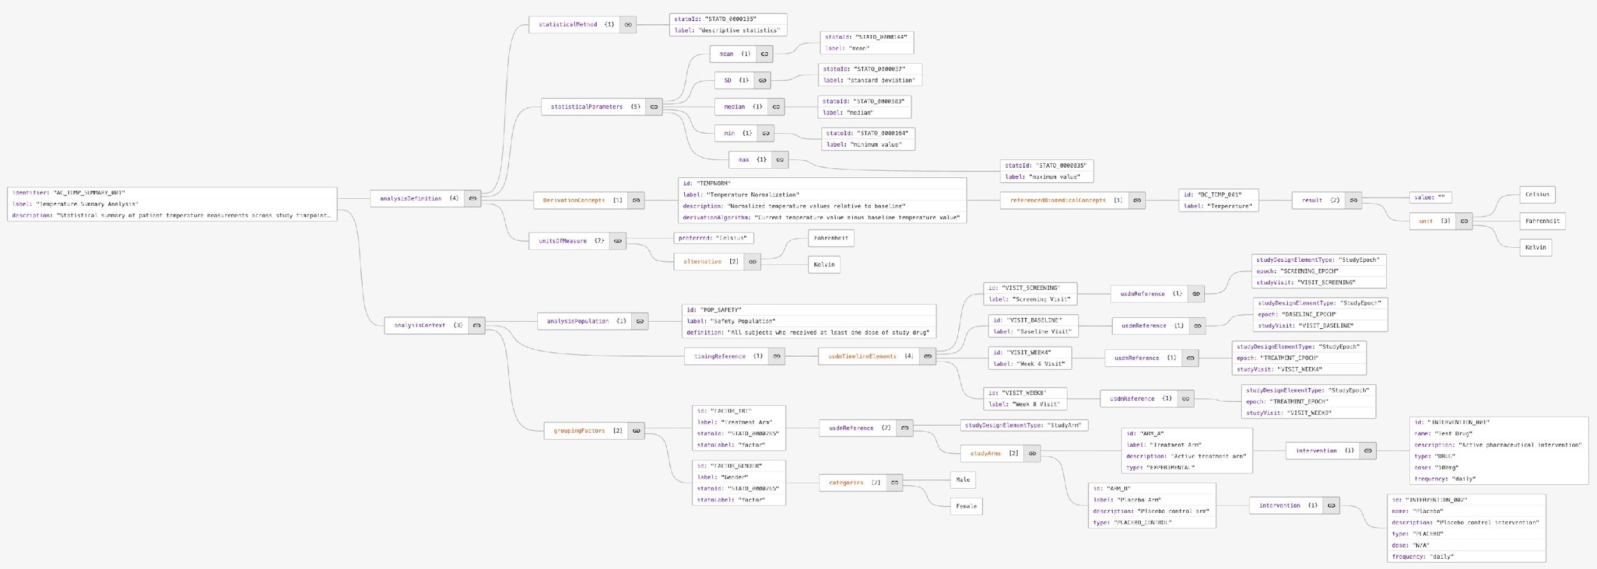
Working Towards a Logical Model
endpoint
BC
timing
statistical method
Change in ADAS-Cog at Week 24 based on an ANCOVA model, which includes the
baseline score, site, and treatment as continuous variable
covariates
#ClearDataClearImpact

Slide 21

 | Derivation Concept - DC | Analysis Concept - AC
Covers | Handling of subject-level data prior to analysis | Analysis and creation of non-subject-level data
Purpose | Generates new derived data from collected or derived data | Examines existing data to draw conclusions, identify patterns and test hypotheses
Process | From SDTM to ADaM | From ADaM to ARS
Outcome | Derived data that serve as input for subsequent derivations or analyses | Aggregated data that produce insights, conclusions, or evaluations
Methods | Mathematical operations and algorithms | Statistical methods
Examples | Change from Baseline Analysis Visit - Week 24 Safety Analysis Set | Mean ANCOVA Mixed Model

Slide 22
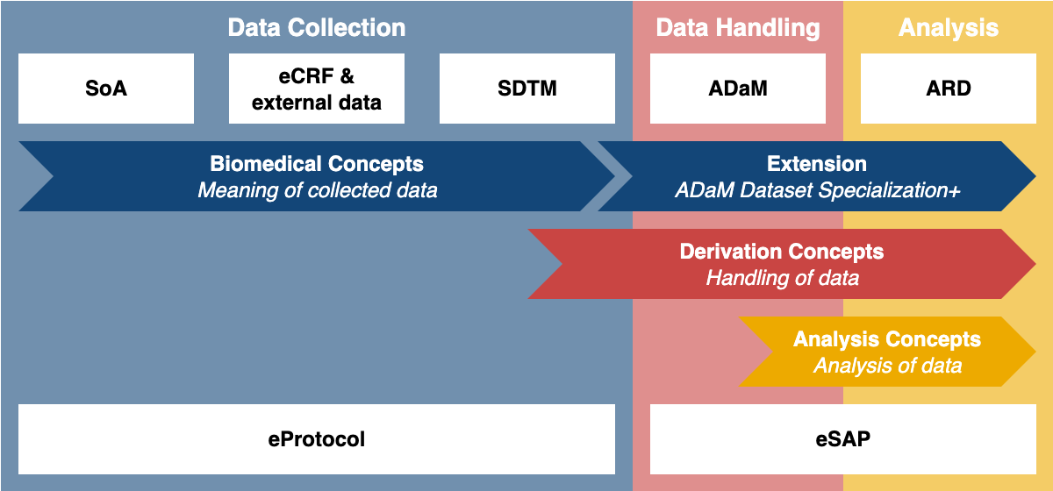
How it fits in

Slide 23
Layers
 | Conceptual layer | Implementation layer*
Definition | Description of the concept in the real world, independent of study and data standards | Representation of the concept instantiated in a data standard
Context | Not context dependent | Context dependent
For data collection | Biomedical Concept | SDTM Dataset Specialization
Examples | Change from Baseline Safety Analysis Set Mean ANCOVA | CHG = AVAL - BASE where SAFFL EQ ‘Y’ mean(x) proc glm data=x; class…
See ISO 11179 for more information
* Representational layer in ISO 11179
#ClearDataClearImpact

Slide 24
Next Steps
Develop Data Model and examples
Define the boundaries between USDM, Analysis Results Standard, Biomedical Concepts, and Analysis Concepts / Derivation Concepts
Determine how to leverage existing ontologies such as STATO
Determine how to make this relatable to the CDISC community
Creation of an eSAP
#ClearDataClearImpact

Slide 25
Thank You!
Karl Wallendszus karl.wallendszus@ndph.ox.ac.uk
Edwin van Stein evanstein@cdisc.org
25

